Slide 1

Curriculum review
Image from: https://www.thekingstonacademy.org/academy-life/curriculum-2

Slide 2
Table of content
Table of content
Program overview
Curriculum courses, credits and hours
Course content
Organisation of a working year
Distribution of hours
Balances
Student‘s workload

Slide 3
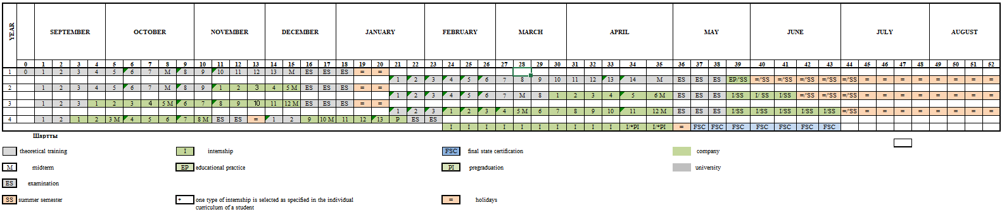
Weekly plan program overview

Slide 4
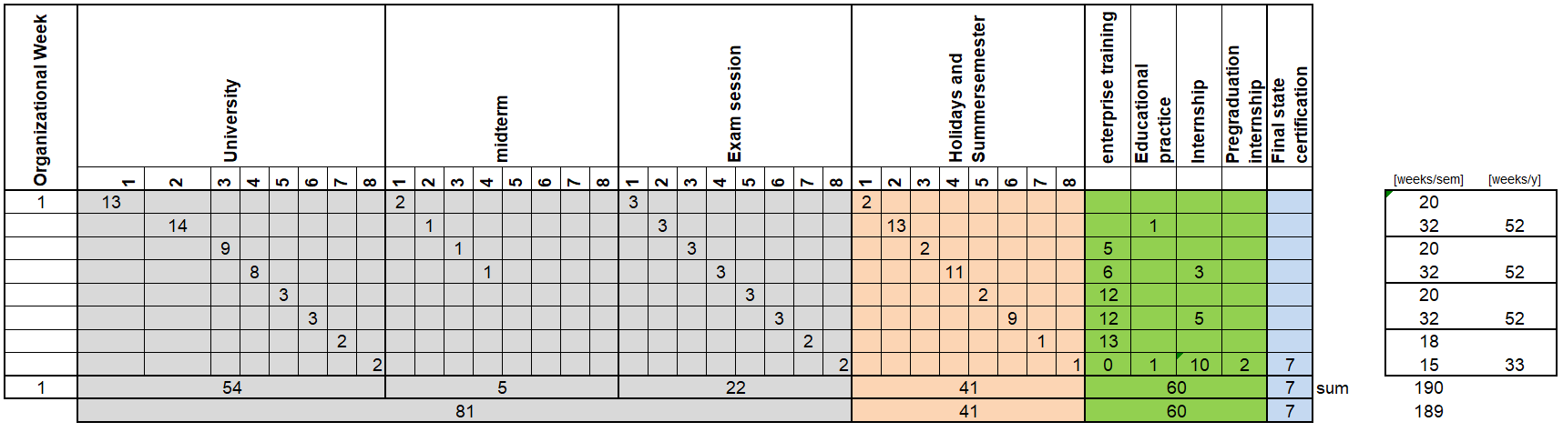
Weekly plan

Slide 5
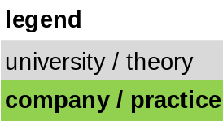
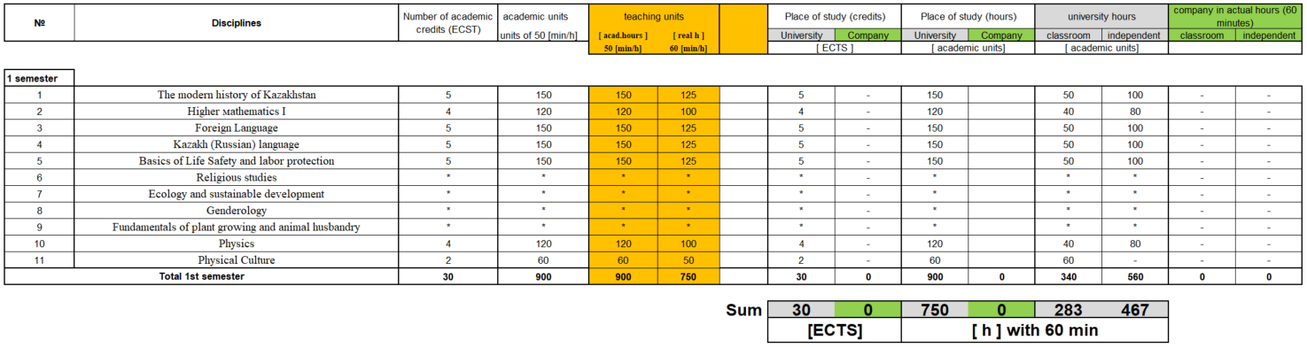
Course content per semester

Slide 6
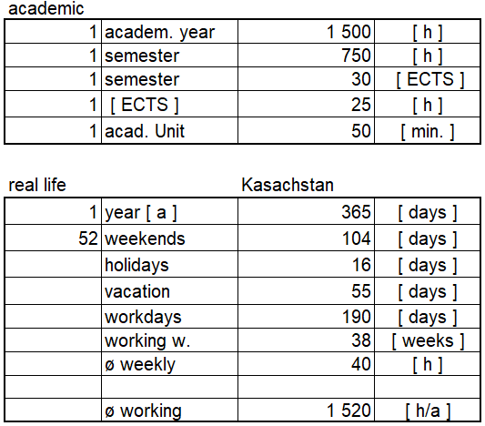
Hours, weeks and duration of a year due to gegorian calendar

Slide 7
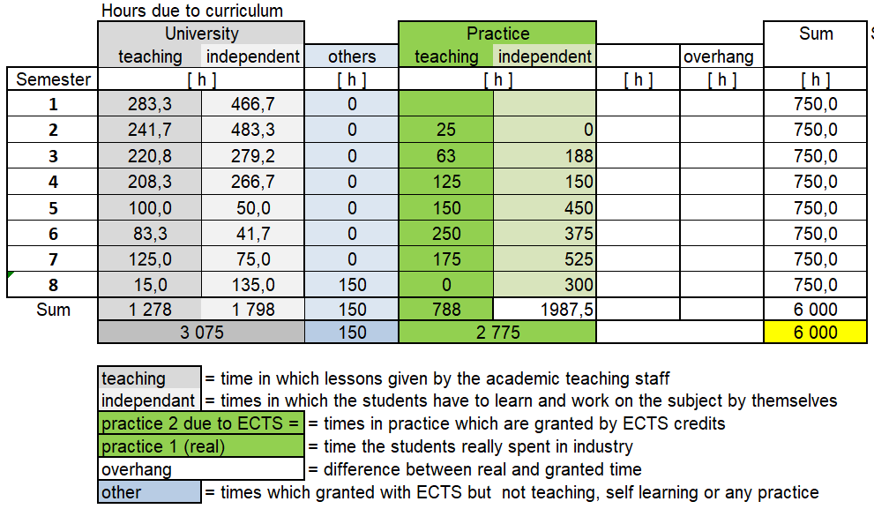
Distribution of hours

Slide 8
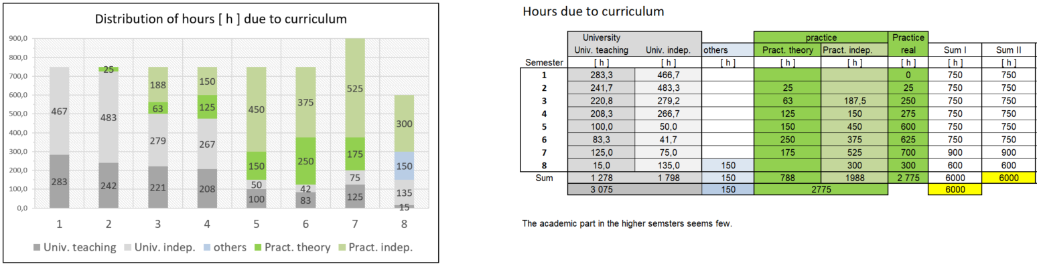
Distribution of hours (overview)

Slide 9
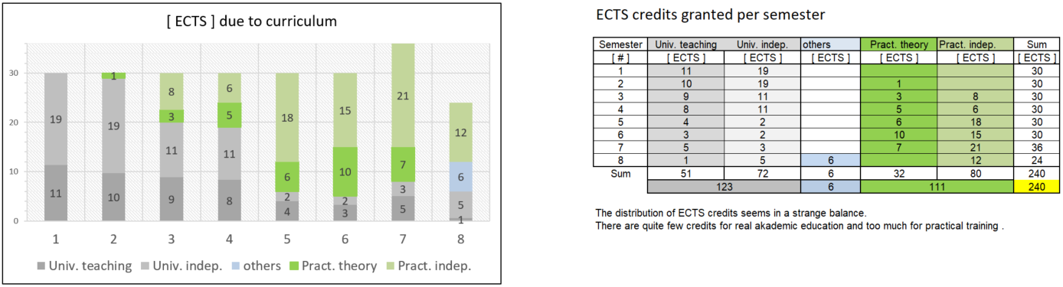
Distribution of ects (overview)

Slide 10
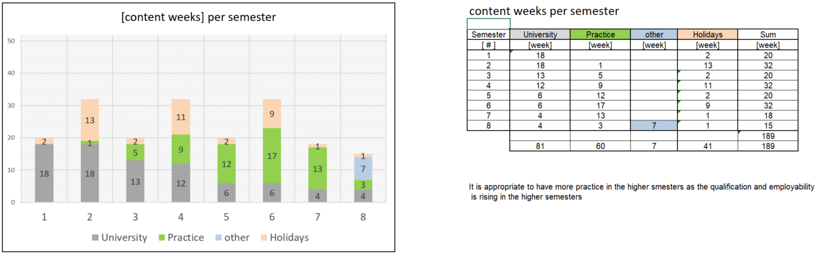
Content weeks per semester (overview)

Slide 11
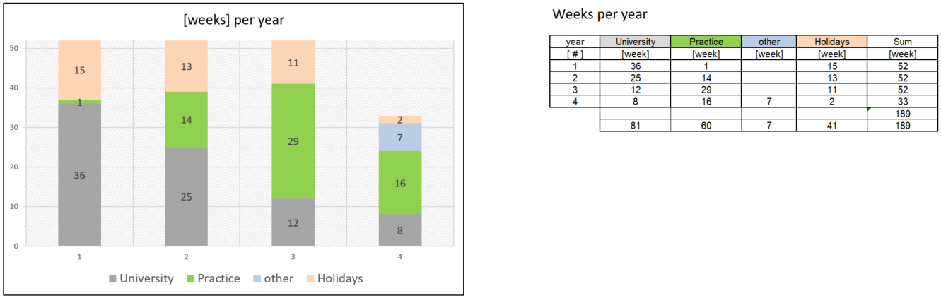
Content weeks per year (overview)

Slide 12
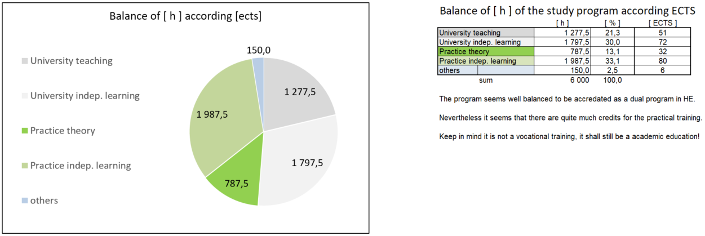
Balance of hours and ects credits

Slide 13
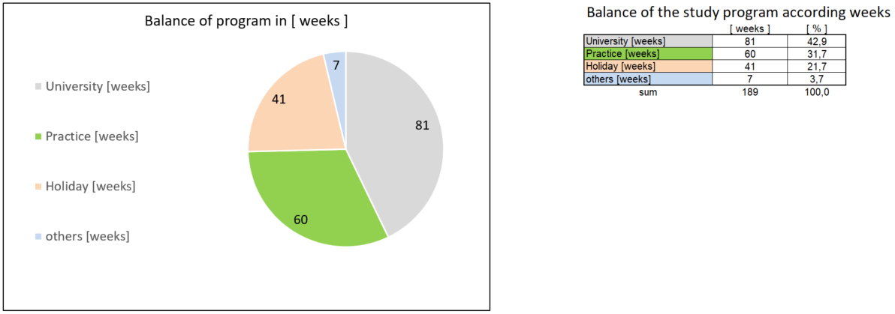
Balance of weeks

Slide 14
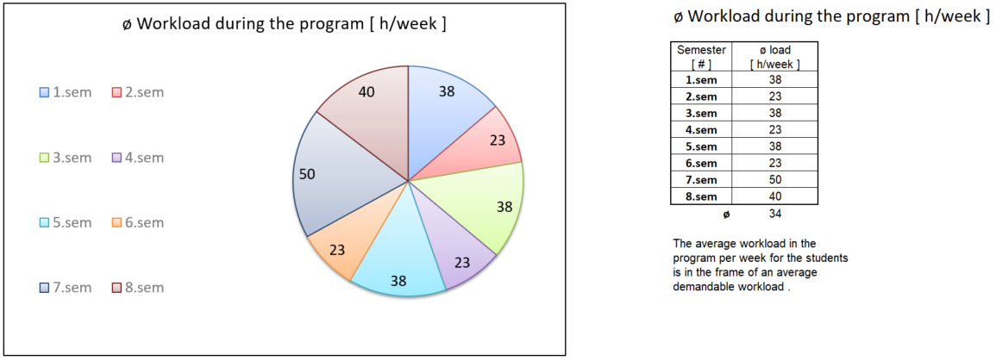
Student‘s workload per semester

