Slide 1



6M in dual training
Ikombayev Talgat Dyusyumbekovich
Senior lecturer of the Department of Industrial Engineering and Design
Innovative University of Eurasia
June 18, 2021

Slide 2
Content
Application of 6M in dual training
Experience in the construction of dual training, in particular in the field of mechanics and mechanical processing
Goal: Show the vision of dual learning
Рrompt № 1 | М......
Рrompt № 2 | М......
Рrompt № 3 | М......
Рrompt № 4 | М......
Рrompt № 5 | М......
Рrompt № 6 | М......

Slide 3

Рrompt №1. Best advice

Slide 4
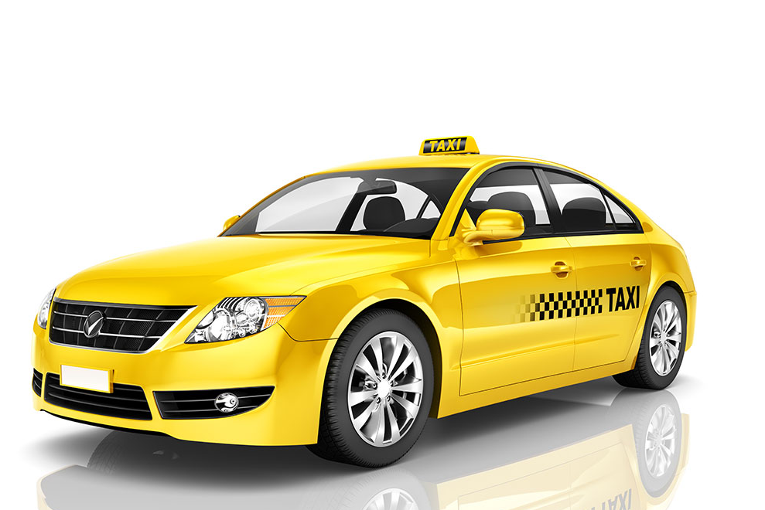
«If you don't want to be a taxi driver,
don't take advice from taxi drivers »

Slide 5
Рrompt №1 Man (Mentor)
Whether the personnel's technology proficiency and experience are up to standard? Does the staff have quality consciousness, sense of responsibility and disciplines?
Implementation
InEU Alumni Association
Personal contacts
The company's interest in training personnel
Involvement of production representatives in conducting classes
Рrompt № 1 | Man (Mentor)
Рrompt № 2 | М......
Рrompt № 3 | М......
Рrompt № 4 | М......
Рrompt № 5 | М......
Рrompt № 6 | М......

Slide 6
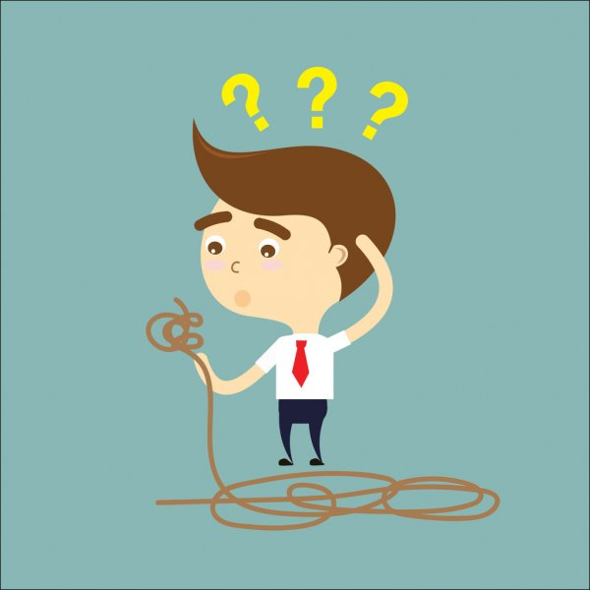
Рrompt №2. Best aphorism

Slide 7
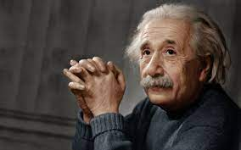
«The problem that occurs at a certain level
is not solved at the same level»
Einstein

Slide 8

Рrompt №2 Methods
Рrompt № 1 | Man (Mentor)
Рrompt № 2 | Methods
Рrompt № 3 | М......
Рrompt № 4 | М......
Рrompt № 5 | М......
Рrompt № 6 | М......
The impact of gadgets
WHY they love gadgets?

Slide 9
WHY they love gadgets?
High level of stimulation (imitation)
Colour
Sound
3D
Fun/ not boring
Instantly
no punishment

Slide 10
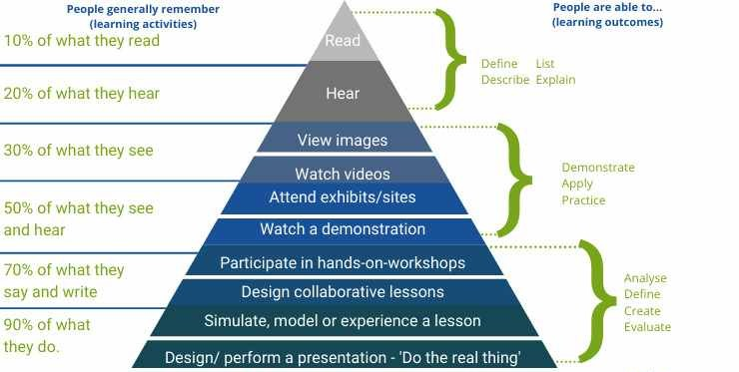
Dale's cone

Slide 11
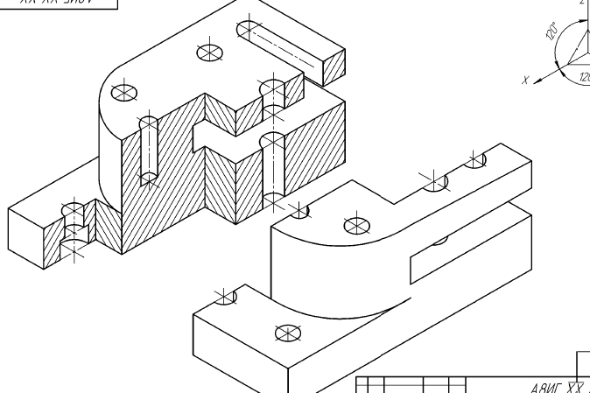
Example of gamification

Slide 12
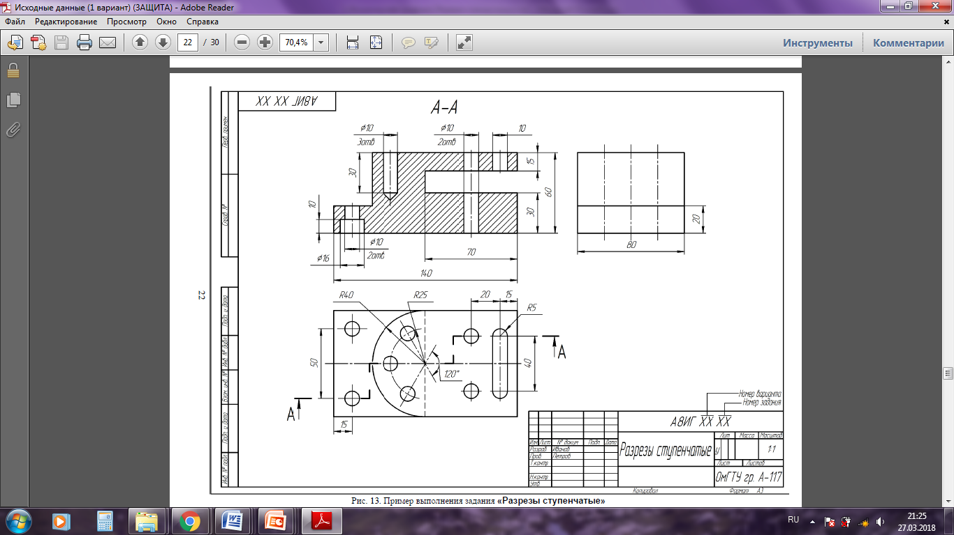

Slide 13
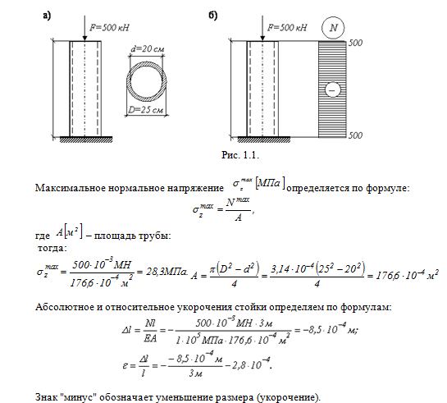
Don't break the system

Slide 14
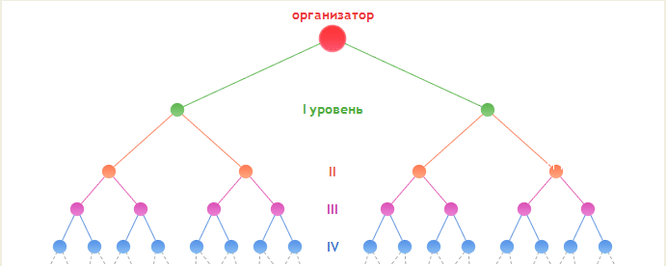
Cascade learning model
Conclusion .
Gamification.
High level of stimulation (as in gadgets).
Don't break the system.

Slide 15

Рrompt №3.
«If you have no enemies,
then you have no principles»
The Mafia Manager: A Guide to the Corporate Machiavelli

Slide 16
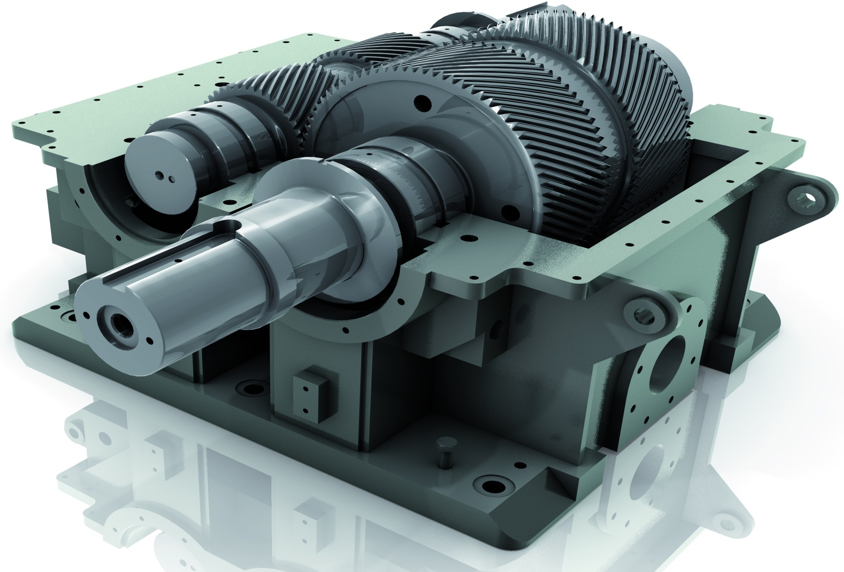

Рrompt №3. Materials
Рrompt № 1 | Man (Mentor)
Рrompt № 2 | Methods
Рrompt № 3 | Materials
Рrompt № 4 | М......
Рrompt № 5 | М......
Рrompt № 6 | М......

Slide 17
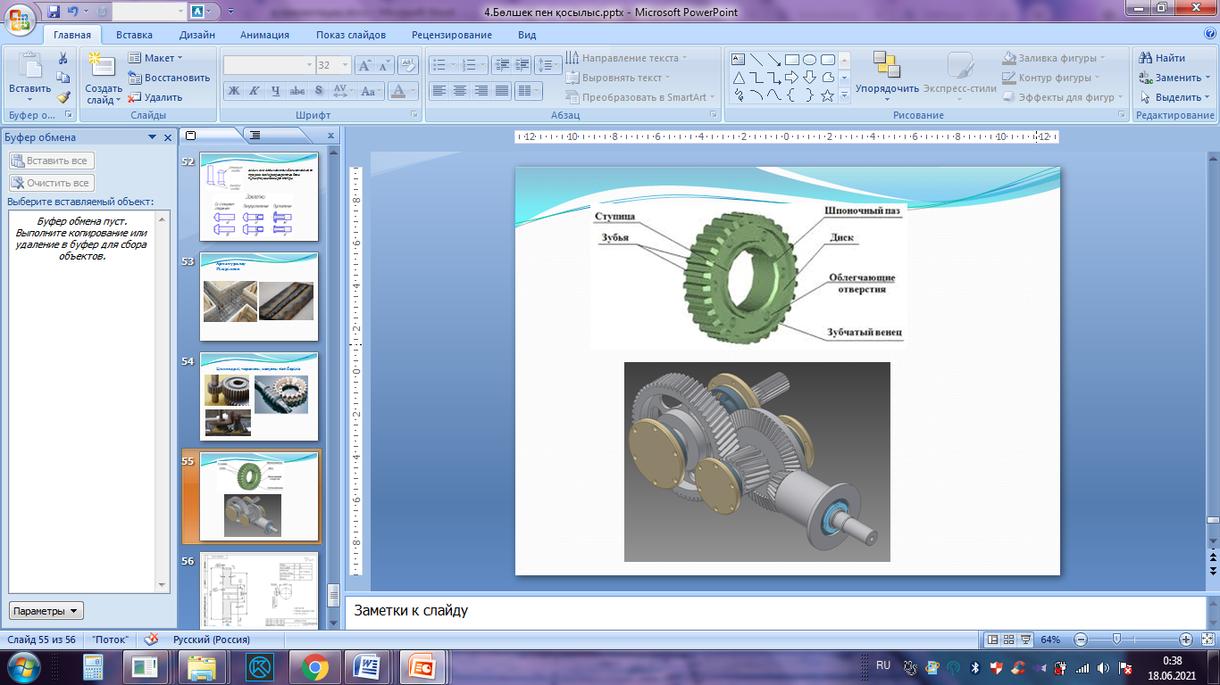
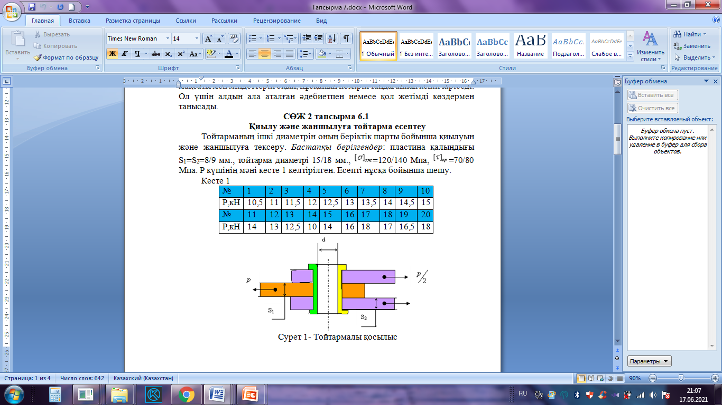
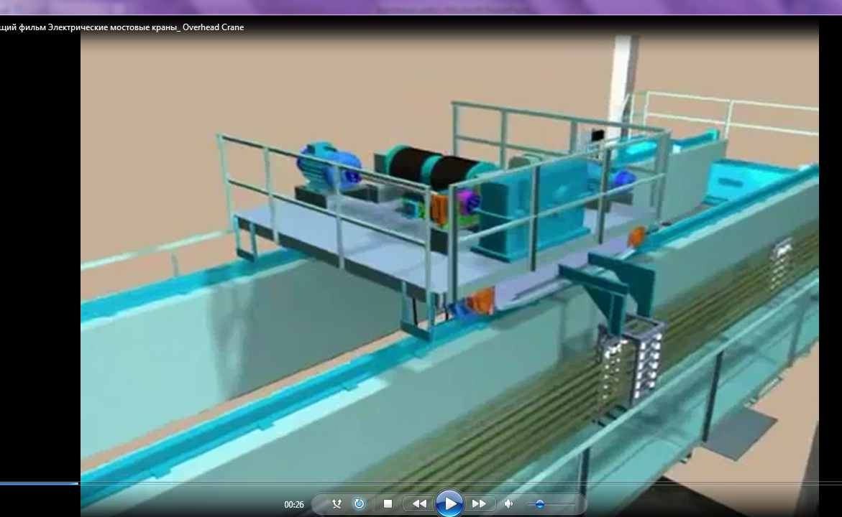
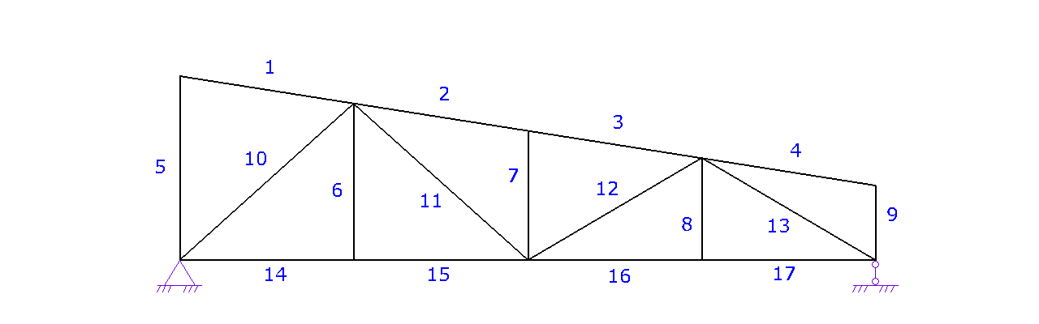

Slide 18

Рrompt №4.
The Mental Law of Price:
" If you Didn't Get Something,
you Didn't pay the price for it

Slide 19
Рrompt №4. Motivation
Рrompt № 1 | Man (Mentor)
Рrompt № 2 | Methods
Рrompt № 3 | Materials
Рrompt № 4 | Motivation
Рrompt № 5 | М......
Рrompt № 6 | М......

Slide 20
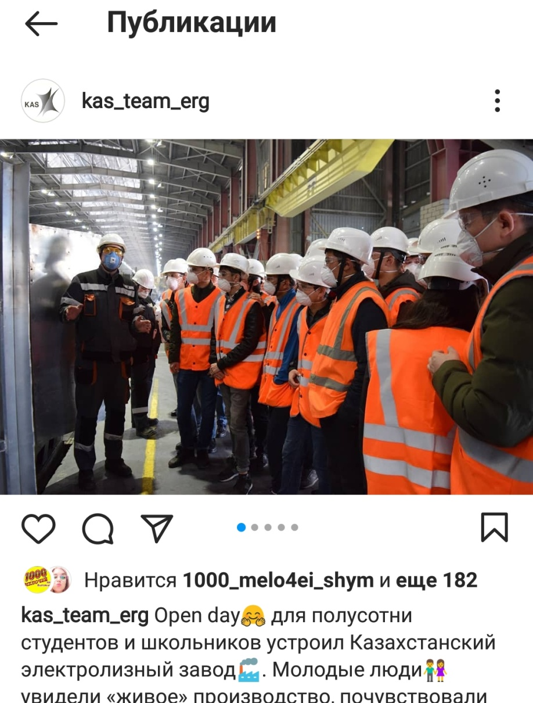
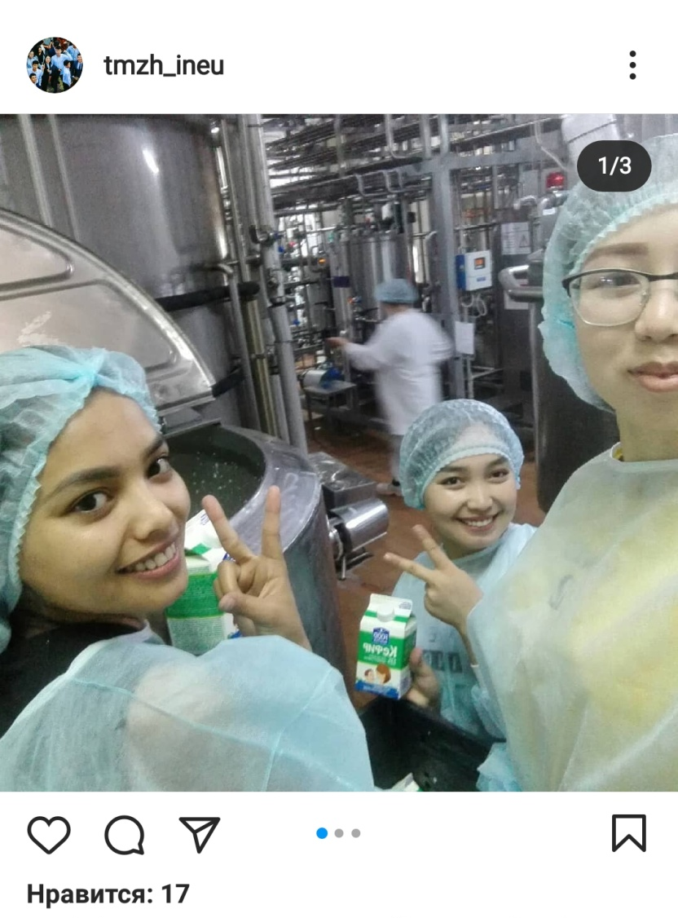
Scholarship 1+1=2 2+1=3

Slide 21
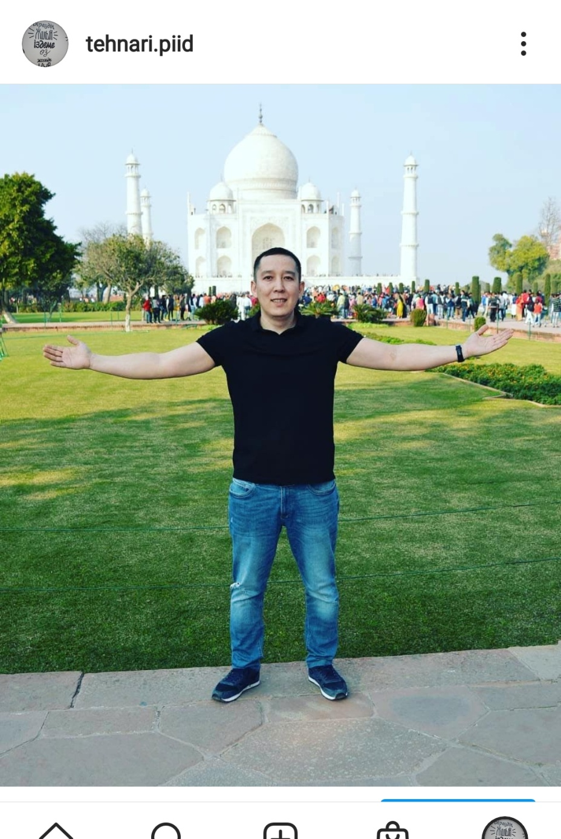
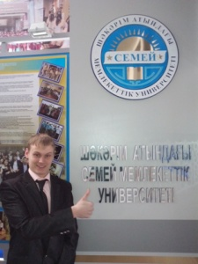
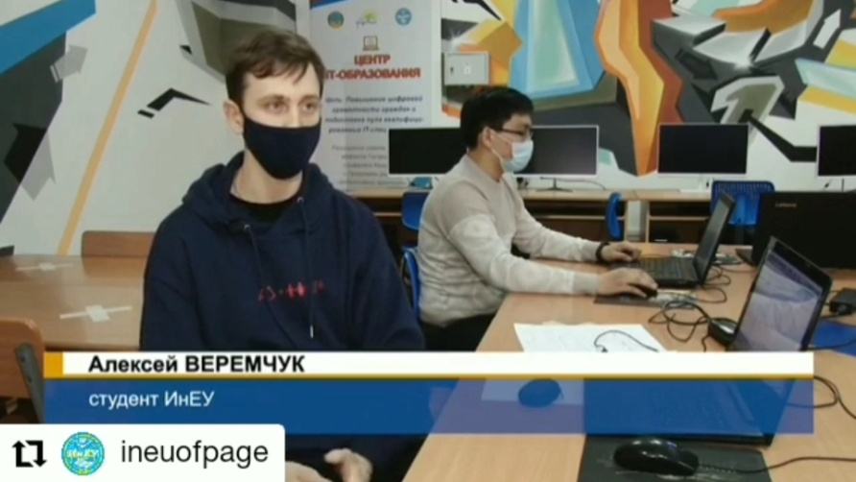
self-realization/membership
case solving championship
subject olympiads
Enactus

Slide 22
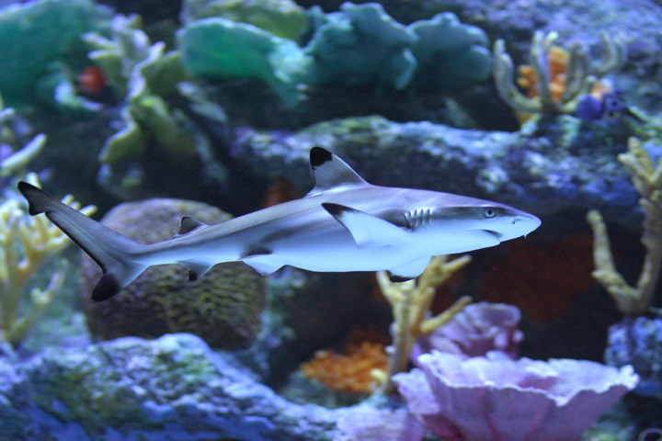
Рrompt №5.
Fact
The shark in the aquarium , grows up to 20 cm,
and in the ocean the length can reach 2.5 m. It can never outgrow its habitat.

Slide 23
Рrompt №5. Milieu (money)
Рrompt № 1 | Man (Mentor)
Рrompt № 2 | Methods
Рrompt № 3 | Materials
Рrompt № 4 | Motivation
Рrompt № 5 | Milieu (money)
Рrompt № 6 | М......

Slide 24
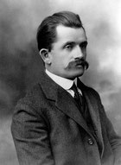
Рrompt №6.
"It all started with the fact that I looked around and, not seeing the car of my dreams, decided to build it myself.“
Ferdinand Porsche

Slide 25
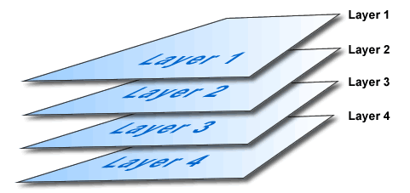
Рrompt №6. Machine
Рrompt № 1 | Man (Mentor)
Рrompt № 2 | Methods
Рrompt № 3 | Materials
Рrompt № 4 | Motivation
Рrompt № 5 | Milieu (money)
Рrompt № 6 | Machine
TNK Aksu Ferroalloy Plant /
Kazakhstan Electrolysis Plant
JSCRubiKom LLP/FoodMaster
LLPPavlodar Petrochemical Plant LLP

Slide 26
Thank you for your attention!

